Slide 1
Computer Modelling and Simulation
Lectures 1 and 2

Slide 2
Introduction to Modelling and Simulation
Modeling and Simulation (M&S) is a separate discipline with it’s own body of knowledge, theory and research methodology.
M&S is founded on the following concepts:
Modeling: Models are approximations for the real - world .
Simulation: Repeated observation of the model.
Analysis: Aids in the ability to draw conclusions and make recommendations based on various iterations or simulations of the model.
Visualization: The ability to represent data as a way to interface with the model
Verification and Validation

Slide 3
Modelling and Simulation
Modelling and simulation (M&S) is the use of models as a basis for simulations to develop data utilized for managerial or technical decision making.

Slide 4
What you’ll be able to do after this course?
Make simulations of different types of systems used in real world with the help of a simulation software i.e. AnyLogic.
Create mathematical and graphical models of natural phenomena like population growth, predator-prey relationships, drug-dosage model, fall under gravity, spread of SARS etc
Study numerical solutions for the mathematical models of the systems
Study different types of modeling techniques (like Petri Nets, Cellular Automata etc) to represent systems.
Understand the role of randomness in real-world systems and model that randomness.

Slide 5
Mathematical Model of different systems
Predator Prey Relationship
ds/dt = ks s – khshs
dh/dt = ksh sh – kh h
Drug dosage Model
elimination = elimination_constant * aspirin_in_plasma
plasma_concentration = aspirin_in_plasma/plasma_volume

Slide 6
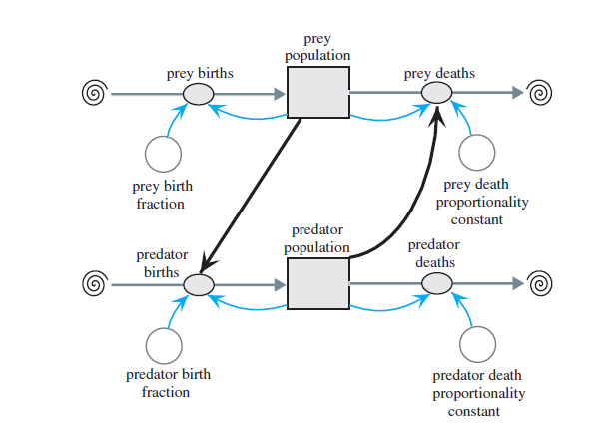
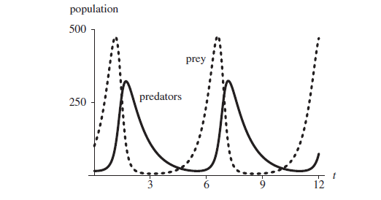
Graphical Representation of Predator-Prey Relationship and It’s analysis

Slide 7
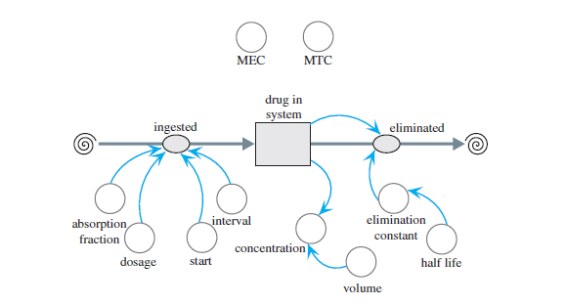
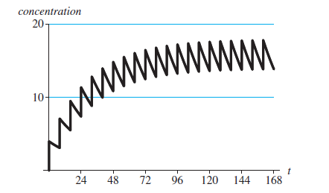
Graphical Representation of Drug Dosage Model and It’s analysis

Slide 8
Applications of M & S
Training — goal is to provide real - world experience/opportunities in a controlled environment e.g. flight simulator
Decision Support — to provide a descriptive, explanatory, predictive tool
Understanding — this type of modeling and simulation facilitates testing a hypothesis relative to the structure and function of a complex system e.g. modeling spread of covid or other infectious diseases
Education and Learning — used for teaching and learning systems with dynamic behavior and with serious gaming (this is also called game – based learning) e.g SuperBetter (a motivational game), FoldIt (puzzle solving game for the benefit of scientific research)
Entertainment — simulation provides a realistic representation for elements possessing dynamic behavior e.g. modern video games

Slide 9
How learning M&S will help you?
Job opportunities
https://www.glassdoor.com/Job/simulation-and-modeling-jobs-SRCH_KO0,23.htm
https://www.ziprecruiter.com/Jobs/Modeling-and-Simulation-Analyst

Slide 10
Pre-Requisites
Knowledge of Basic Mathematics
Knowledge of Programming Language
Willingness to work on many assignments and class activities

Slide 11
Course Policies
Attendance (strict 80% attendance - no compromise on attendance)
Zero Tolerance Policy for Plagiarism in assignments -(again no compromise)
Grading Policy:
Relative

Slide 12
Evaluations in the course
Quizzes - 5%-10%
Assignments - 15%
Sessionals (1&2) - 30% each
Final Exam - 45%-50%

Slide 13
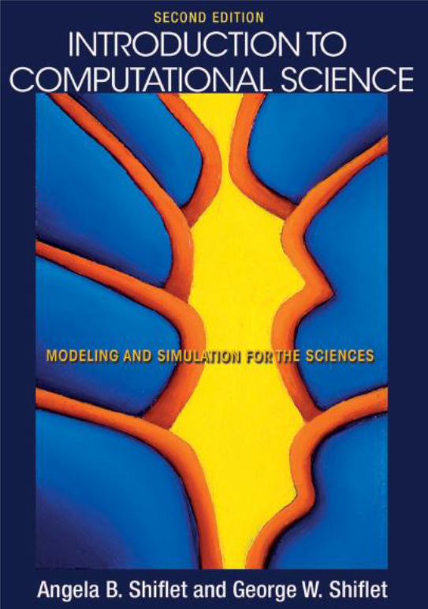
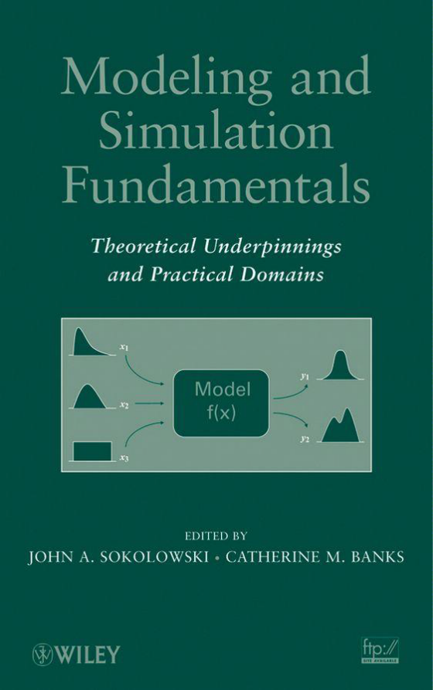
Recommended Books

Slide 14
Learning Resources
AnyLogic Video Tutorials
AnyLogic Youtube Channel

Slide 15

What is this?
This is not an apple.
It’s a representation of an apple
Sufficient for those who want to know what an apple looks like but not for those who want to know how it tastes like

Slide 16
What is a model?
A model is an abstract representation of a system.
An abstraction in which only the essential ingredients are retained according to the questions we ask about the system.
Level of details?
“Everything should be made as simple as possible but not simpler.” Albert Einstein.
The same system can be described at different scales.
Cells, tissues, organs, living beings
Mechanical parts, cars, traffic

Slide 17
System
The term "system" comes from the Latin word systēma, "whole concept made of several parts or members”
An entity or group of entities that exist and operate in time and space.
International Council of Systems Engineering INCOSE suggests that a system is a construct or collection of different elements that together produces results not obtainable by the elements alone.
System refers to the subject of model development; that is, it is the subject or thing that will be investigated or studied using M & S.

Slide 18
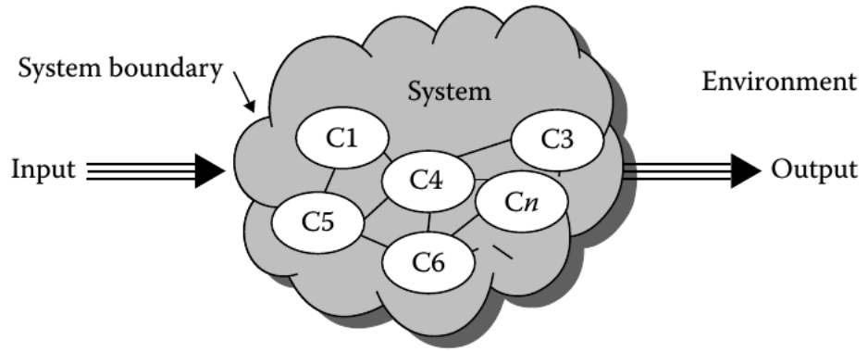
System

Slide 19
System
Examples
Planetary system in the universe (gravitation bound objects in orbit around a star)
Banking system in finance industry (payment, loan, deposit, investment processes)
Software system in a computer (processes, threads, IPC, etc.)
Other examples are in medicine, biology, socio-economic, political, communications, environment, transportation, electrical, mechanical, etc

Slide 20
Types of Models
Physical
Notional

Slide 21
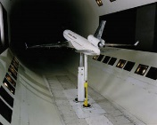
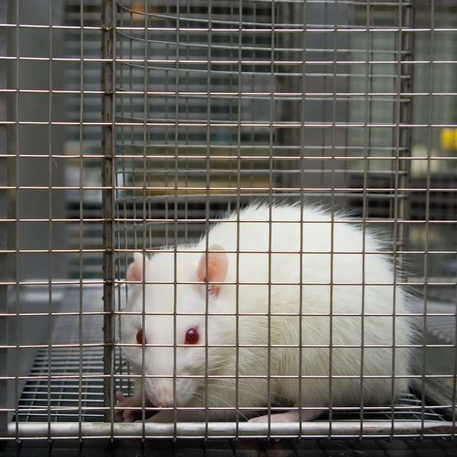
Types of Models
A model can be physical , such as a scale model of an airplane to study aerodynamic behavior.

Slide 22
Types of Models
A model can be notional i.e. a model consists of a set of mathematical equations or logic statements that describes the behavior of the system.
Mathematical model
Simple equations often result in analytic solutions that has mathematical proofs.
Some mathematical models require numerical solutions
Logical model
Software analysis/design models, computer programs.

Slide 23
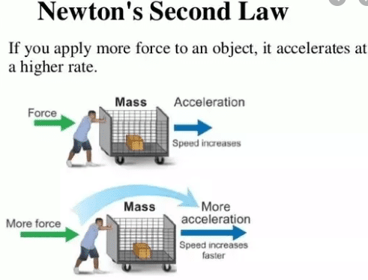
Example of Mathematical model
F = ma

Slide 24
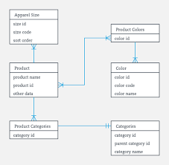
Example of a Logical model
An example Class Diagram

Slide 25
Mathematical Model of a free falling body
Consider a model that represents the vertical height of an object moving in one dimension under the influence of gravity.
The mathematical model takes the form of an equation
h = 1/2 at² + vt + s
where
h = height (feet),
t = time in motion (seconds),
v = initial velocity (feet per second, + is up),
s = initial height (feet),
a = acceleration (feet per second per second).

Slide 26
Simulation
Multiple definitions:
a nontechnical meaning not real, imitation
• A method for implementing a model over time.
• a technique for testing, analysis, or training in which real - world systems are used
• an unobtrusive scientific method of inquiry involving experiments with a
model rather than with the portion of reality that the model represents
• a methodology for extracting information from a model by observing the
behavior of the model as it is executed

Slide 27
Simulation of a free falling body
Simulation Example 1
/* Height of an object moving under gravity. */
/* Initial height v and velocity s constants. */
main()
{
float h, v = 100.0, s = 1000.0;
int t;
for (t = 0, h = s; h >= 0.0; t++)
{
h = ( -16.0 * t * t) + (v * t) + s;
printf(“Height at time %d = %f\n ”, t, h);
}
}

Slide 28
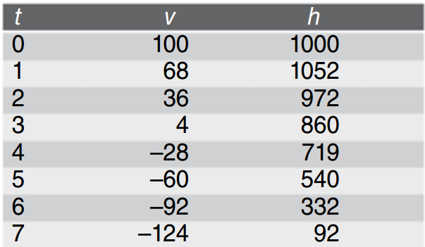
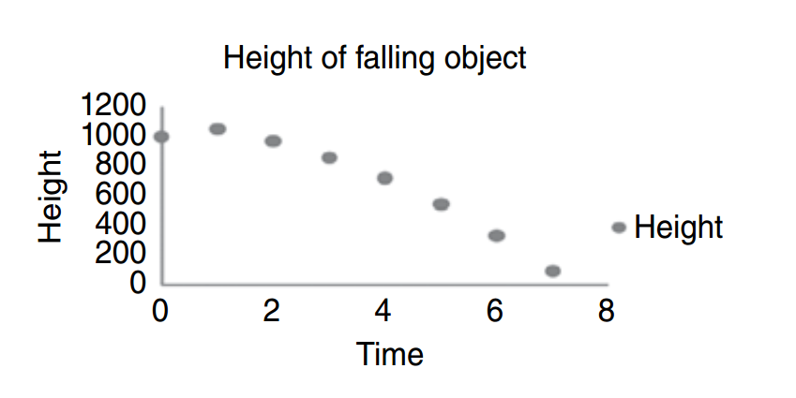
Simulation of a free falling body

Slide 29
Another definition of Simulation
Sometimes the mathematical model is sufficiently complex that the only way to solve the equations is numerically. This process is referred to as computer simulation .
Essentially, a system is modeled using mathematical equations; then, these equations are solved numerically using a digital computer to indicate likely system behavior.
Analytic solutions are precise mathematical proofs, and as such, they cannot be conducted for all classes of models.
The alternative is to solve numerically with the understanding that an amount of error may be present in the numerical solution.

Slide 30
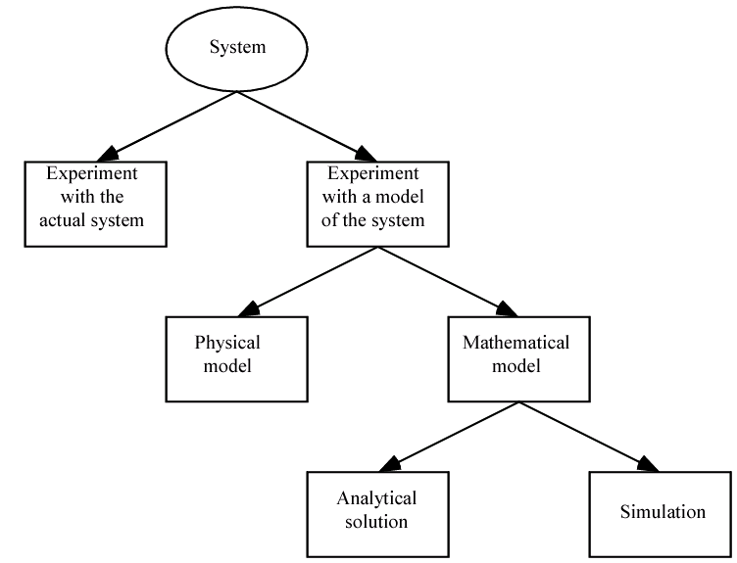
Another definition of Simulation

Slide 31
Types of Simulation
Live Simulation
Virtual Simulation
Constructive simulation

Slide 32
Types of Simulation
A live simulation involves real people operating real systems.
Example: War games
The purpose of live simulation training is to provide a meaningful and useful experience for the trainee.

Slide 33
Types of Simulation
A virtual simulation is different from live simulation in that it involves real people operating in simulated systems.
These systems are recreated with simulators, and they are designed to immerse the user in a realistic environment.
Example: Cockpit simulator

Slide 34
Types of Simulation
Constructive simulation
This simulation involves real people making inputs into a simulation that carry out those inputs by simulated people operating in simulated systems.
The expected result of constructive simulation is that it will provide a useful result.
Example: SimCity

Slide 35
Advantages of M&S
The ability to choose correctly by testing every aspect of a proposed change without committing additional resources.
Compress and expand time to allow the user to speed up or slow - down behavior or phenomena to facilitate in - depth research
Understand why by reconstructing the scenario and examining the scenario closely by controlling the system
Explore possibilities in the context of policies, operating procedures, methods without disrupting the actual or real system
Diagnose problems by understanding the interaction among variables that make up complex systems
Develop understanding by observing how a system operates rather than predictions about how it will operate
Visualize the plan with the use of animation to observe the system or organization actually operating
Better training can be done less expensively and with less disruption than on - the - job training

Slide 36
Disadvantages of M & S
Simulation results may be difficult to interpret
Some simulations may take months to complete
Some simulations may require expensive hardware
Some simulations may be run when they are not needed. For example,when analytical solutions are available.

Slide 37
Domains
Transportation M & S
Business M & S
Medical M & S
Social Science M & S

Slide 38
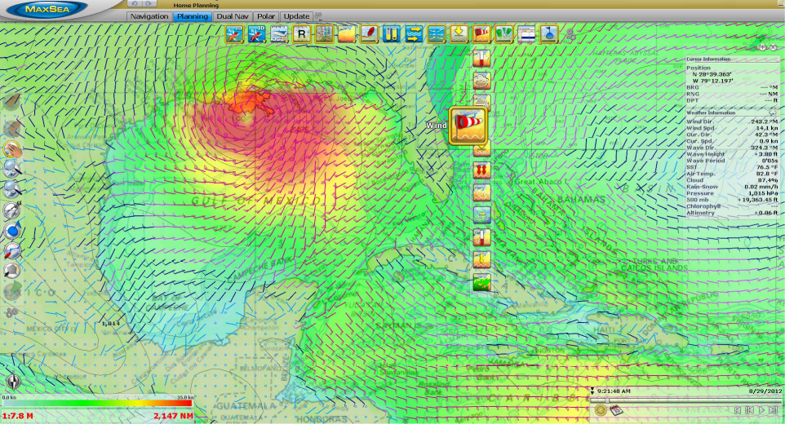
Applications of M & S
Weather Forecasting

Slide 39
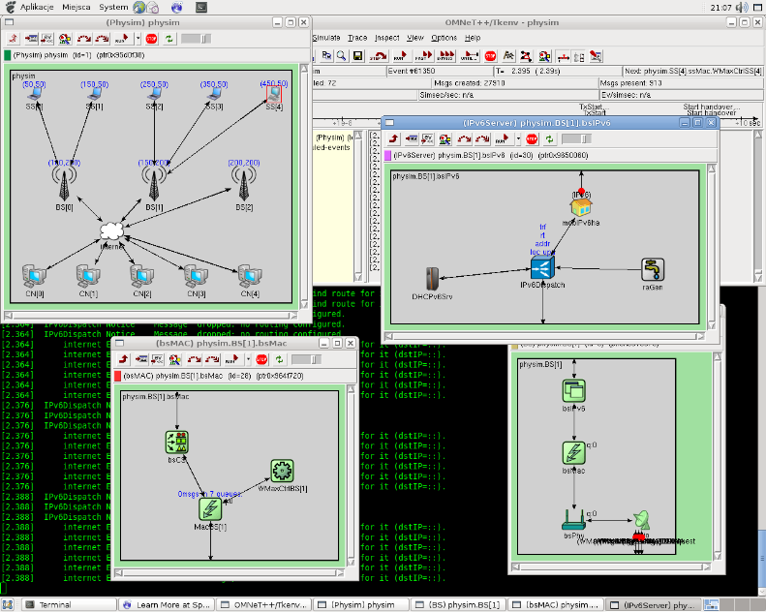
Applications of M & S
Examples of Network Simulations in Omnet++ (IMG: omnetplusplus.blogspot.com)

Slide 40
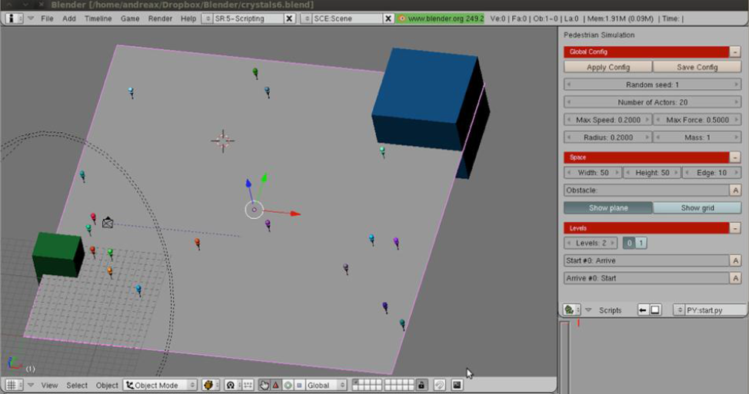
Applications of M & S
Crowd Modelling during Tawaf IMG: L. Manenti et. al., MAKKSim: Dealing with Pedestrian Groups in MAS-based Crowd Simulation

Slide 41
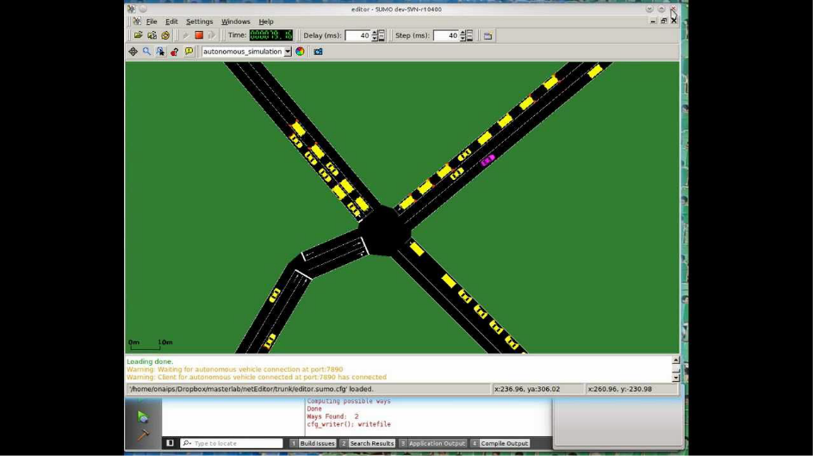
Applications of M & S
Simulation of Urban Mobility (SUMO)

